Slide 1
Lossless Compression -Statistical Model
Part II Arithmetic Coding
115/11/07
Arithmetic Coding

Slide 2
CONTENTS
Introduction to Arithmetic Coding
Arithmetic Coding & Decoding Algorithm
Generating a Binary Code for Arithmetic Coding
Applications of Arithmetic Coding
115/11/07
Arithmetic Coding

Slide 3
Arithmetic Coding
Huffman codes have to be an integral number of bits long, while the entropy value of a symbol is almost always a faction number, theoretical possible compressed message cannot be achieved.
  For example, if a statistical method assign 90% probability to a given character, the optimal code size would be 0.15 bits.
115/11/07
Arithmetic Coding

Slide 4
Arithmetic Coding
Arithmetic coding bypasses the idea of replacing an input symbol with a specific code. It replaces a stream of input symbols with a single floating-point output number.
Arithmetic coding is especially useful when dealing with sources with small alphabets, such as binary sources, and alphabets with highly skewed probabilities.
115/11/07
Arithmetic Coding

Slide 5









Arithmetic Coding Example (1)
Character probability Range
^(space) 1/10
A 1/10
B 1/10
E 1/10
G 1/10
I 1/10
L 2/10
S 1/10
T 1/10
Suppose that we want to encode the message
BILL GATES
115/11/07
Arithmetic Coding

Slide 6
Arithmetic Coding Example (1)
0.2
0.2572
0.0
0.25
0.256
^
^
0.1
0.25724
A
0.2
B
0.3
E
0.4
G
0.5
0.25
I
I
0.6
0.26
0.2572
0.256
L
L
L
0.8
0.258
0.2576
S
0.9
T
0.26
0.258
1.0
0.3
0.2576
115/11/07
Arithmetic Coding

Slide 7
Arithmetic Coding Example (1)
  New character Low value high value
  B 0.2 0.3
  I 0.25 0.26
  L 0.256 0.258
  L 0.2572 0.2576
  ^(space) 0.25720 0.25724
  G 0.257216 0.257220
  A 0.2572164 0.2572168
  T 0.25721676 0.2572168
  E 0.257216772 0.257216776
  S 0.2572167752 0.2572167756
115/11/07
Arithmetic Coding

Slide 8
Arithmetic Coding Example (1)
The final value, named a tag, 0.2572167752 will uniquely encode the message ‘BILL GATES’.
Any value between 0.2572167752 and 0.2572167756 can be a tag for the encoded message, and can be uniquely decoded.
115/11/07
Arithmetic Coding

Slide 9
Arithmetic Coding
Encoding algorithm for arithmetic coding.
    Low = 0.0 ; high =1.0 ;
    while not EOF do
    range = high - low ; read(c) ;
    high = low + range×high_range(c) ;
    low = low + range×low_range(c) ;
    enddo
    output(low);
115/11/07
Arithmetic Coding

Slide 10
Arithmetic Coding
Decoding is the inverse process.
Since 0.2572167752 falls between 0.2 and 0.3, the first character must be ‘B’.
Removing the effect of ‘B’ from 0.2572167752 by first subtracting the low value of B, 0.2, giving 0.0572167752.
Then divided by the width of the range of ‘B’, 0.1. This gives a value of 0.572167752.
115/11/07
Arithmetic Coding

Slide 11
Arithmetic Coding
Then calculate where that lands, which is in the range of the next letter, ‘I’.
The process repeats until 0 or the known length of the message is reached.
115/11/07
Arithmetic Coding

Slide 12
r c Low High range
0.2572167752 B 0.2 0.3 0.1
0.572167752 I 0.5 0.6 0.1
0.72167752 L 0.6 0.8 0.2
0.6083876 L 0.6 0.8 0.2
0.041938 ^(space) 0.0 0.1 0.1
0.41938 G 0.4 0.5 0.1
0.1938 A 0.2 0.3 0.1
0.938 T 0.9 1.0 0.1
0.38 E 0.3 0.4 0.1
0.8 S 0.8 0.9 0.1
0.0
115/11/07
Arithmetic Coding

Slide 13
Arithmetic Coding
Decoding algorithm
    r = input_code
    repeat
    search c such that r falls in its range ;
    output(c) ;
    r = r - low_range(c) ;
    r = r/(high_range(c) - low_range(c));
    until r equal 0
115/11/07
Arithmetic Coding

Slide 14
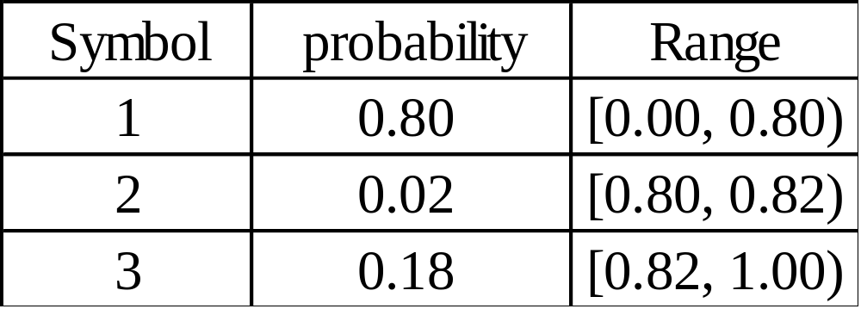
Arithmetic Coding Example (2)
Suppose that we want to encode the message
1 3 2 1
115/11/07
Arithmetic Coding

Slide 15
Arithmetic Coding Example (2)
0.00
0.00
0.7712
0.656
0.7712
1
1
0.7712
0.773504
0.80
2
2
0.82
0.656
0.77408
3
3
1.00
0.77408
0.773504
0.80
0.80
115/11/07
Arithmetic Coding

Slide 16
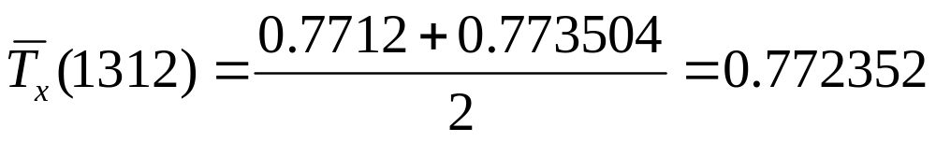
Arithmetic Coding Example (2)
Encoding:
  New character Low value High value
  0.0 1.0
  1 0.0 0.8
  3 0.656 0.800
  2 0.7712 0.77408
  1 0.7712 0.773504
115/11/07
Arithmetic Coding

Slide 17
Arithmetic Coding Example (2)
Decoding:
r | c | low | high | range
0.772352 | 1 | 0 | 0.8 | 0.8 | (0.772352-0)/0.8=0.96544
0.96544 | 3 | 0.82 | 1.0 | 0.18 | (0.96544-0.82) / 0.18=0.808
0.808 | 2 | 0.8 | 0.82 | 0.02 | (0.808-0.8)/0.02=0.4
0.4 | 1 | 0 | 0.8
115/11/07
Arithmetic Coding

Slide 18
Arithmetic Coding
In summary, the encoding process is simply one of narrowing the range of possible numbers with every new symbol.
The new range is proportional to the predefined probability attached to that symbol.
Decoding is the inverse procedure, in which the range is expanded in proportion to the probability of each symbol as it is extracted.
115/11/07
Arithmetic Coding

Slide 19
Arithmetic Coding
Coding rate approaches high-order entropy theoretically.
Not so popular as Huffman coding because ×, ÷ are needed.
Average bits/byte on 14 files (program, object, text, and etc.)
Huff. LZW LZ77/LZ78 Arithmetic
4.99 4.71 2.95 2.48
115/11/07
Arithmetic Coding

Slide 20
Generating a Binary Code for
Arithmetic Coding
Problem:
  The binary representation of some of the generated floating point values (tags) would be infinitely long.
  We need increasing precision as the length of the sequence increases.
Solution:
  Synchronized rescaling and incremental encoding.
115/11/07
Arithmetic Coding

